Slide 1

AGENDA

Slide 2
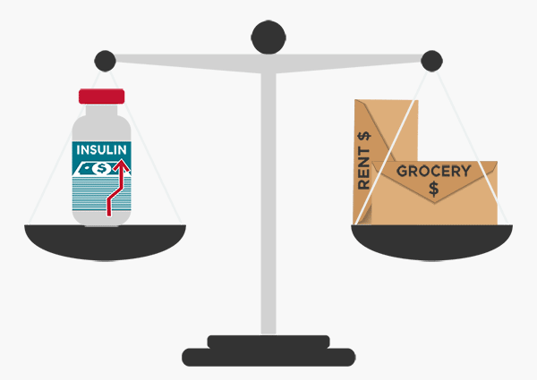
INTRODUCTION
Obstructive sleep apnea (OSA) is a major sleep-disordered breathing (SDB) syndrome that is prevalent in the middle-aged population.
OSA is defined as breathing cessations during sleep, accompanied by oxygen desaturation or arousal for 10-s or more.
Adult men are affected by OSA at a rate of 14%, whereas adult women are affected at a rate of 5%
The classification of apnea is a complex task because the collection of data is quite complex.
Machine learning model (ml) has an advantage over manual examining as it reduces a lot of time spent by the technicians and physicians to conclude whether a person has apnea or not.
Supervised classification is a opt technique because it is related to medical data.

Slide 3
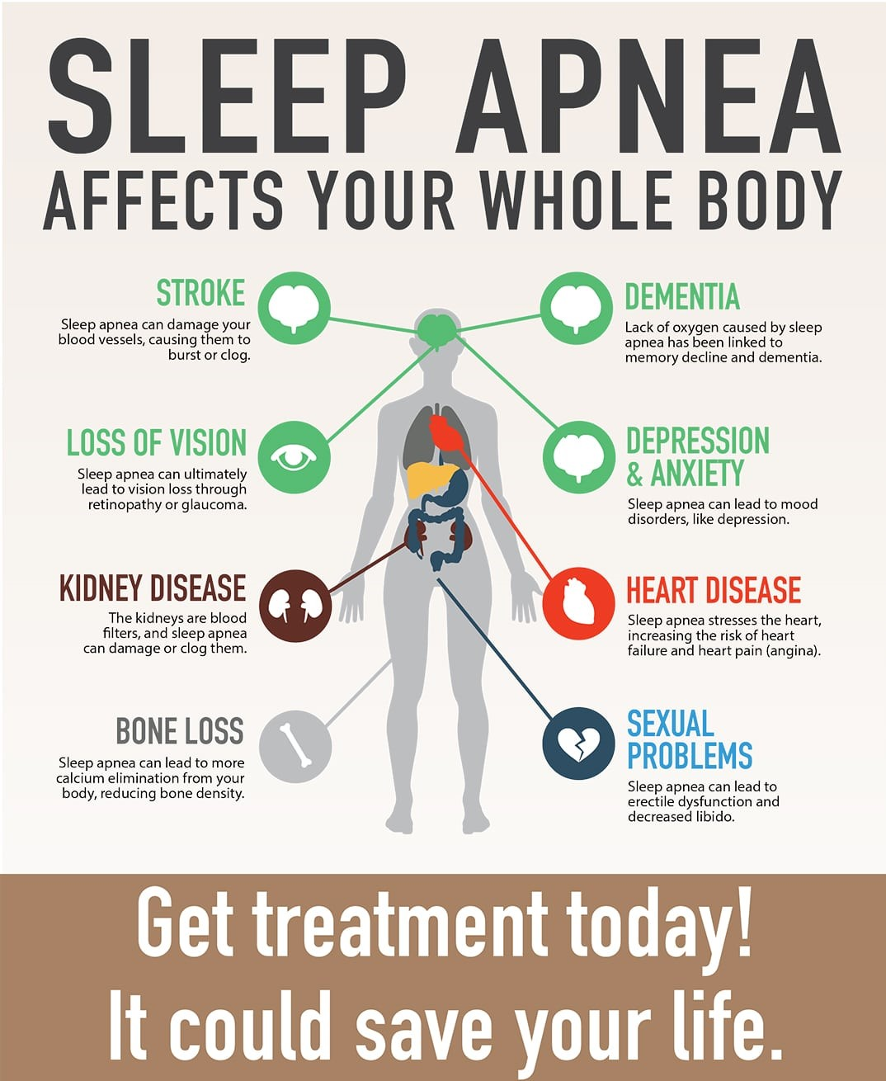
SLEEP APNEA AFFECTS

Slide 4
OBJECTIVE
The main objective of this study is to develop a machine learning (ML)- system for classifying apnea.
To suggest the best classifier for classifying apnea among the patients by comparing the performance metrics.
To create a User Interface (UI) for classifying the apnea and its level, based on the input features (Numerical values).

Slide 5
ABSTRACT
In clinical practice, predicting/classifying the severity of the OSA (Obstructive Sleep Apnea) is still difficult.
To tackle the challenge, a machine learning approach was used to create a classification model for determining OSA severity.
OSA severity has been measured based on the AHI (Apnea-Hypopnea Index).
This study employed TMUH (Taipei Medical University Hospital) sleep center Asians data based on body form profiles and age.
Various supervised machine learning classifiers were chosen based on performance metrics in this work.
The top three classifiers which give the best results are Random Forest, Extra Tree, and Decision Tree with an accuracy of 91%, 90.3%, and 86.2% respectively for the processed data.
A User Interface is created for classifying the severity of apnea.

Slide 6
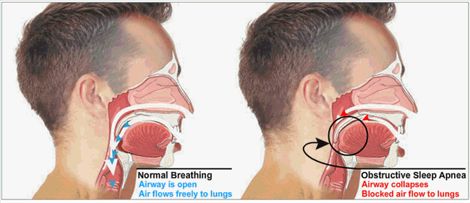
NORMAL BREATHING
OBSTRUCTIVE SLEEP APNEA

Slide 7
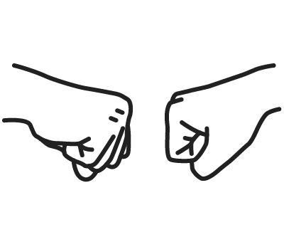
Existing Vs Proposed
Approaches and techniques are minimal and majorly used CNN
Few classification algorithms are been implemented
Mainly focused on accuracy as the performance metrics
Depends on polysomnography for detecting apnea which is costly
No UI (web page) is available for knowing state of persons apnea
8 classification algorithms has been done
Depends on physical body characteristics for classifying apnea which is cheaper
7 performance metrics has been implemented for the classifiers’
A UI (web page) was created for classifying the state of apnea

Slide 8
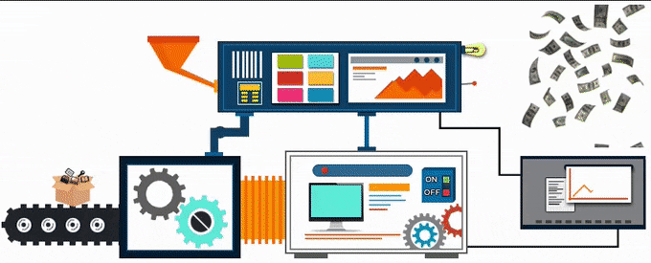
METHODOLOGY
Collection and exploration of the dataset
Pre-processing the dataset
Applying the machine learning models over the pre-processed dataset
Evaluating the results
To create a UI
Analysis
Stimulation
Results
User Interface
Input Features
Deployment

Slide 9
BLOCK DIAGRAM
DATASET
PREPROCESSED DATA
BEST MODEL
PREPROCESSING
TRAIN DATA (80%)
CLASSIFIER
EVALUATE
TEST DATA (20%)

Slide 10
DATA SET EXPLORATION
The data set which is used for this study is Taipei Medical University Hospital (TMUH ) dataset
The data set is publicly available in PLOS ONE (plos.org).
Prediction of the severity of obstructive sleep apnea by anthropometric features via support vector machine (plos.org)
The data set consists of 5241 observations with 11 medical predictor features that are independent.
The target feature is the AHI which is a dependent feature.

Slide 11














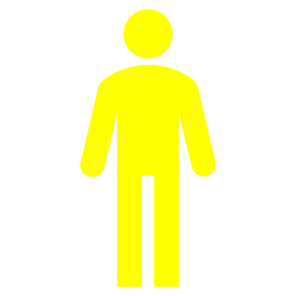


5241 Observations
Male - 3999
Female - 1242

Slide 12
BQ
Berlin Questionnaire(BQ) : Identifies high-risk for OSA in middle-aged and older persons.
Epworth Sleepiness Scale(ESS) : Measure a patient's sleepiness in the daytime.
Body Mass Index(BMI) : The BMI is defined as the body mass divided by the square of the body height(Kg/m2)
Weight: Weight of the person(Kg)
Height: Height of the person(cm)
Head: Head weight(gm)
Neck: Neck size of the person(cm)
Waist: Waist circumference (cm)
Buttock: Buttock circumference(cm)
Age: Personage(Years)
Gender: Male or Female
ESS
GENDER
BMI
AGE
WEIGHT
BUTTOCK
HEIGHT
WAIST
NECK
HEAD

Slide 13
PREPEOCESSING
ONE-HOT ENCODING
AHI VALUE LABELING
OUTLIERS REMOVAL

Slide 14
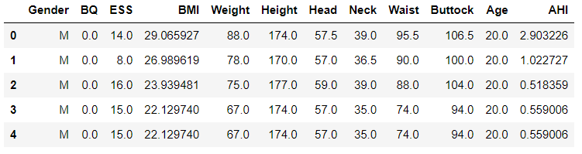
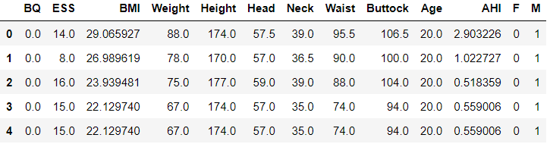
ONE HOT ENCODING
Gender | One Hot Encoded
M | 1
F | 0
Before One-Hot Encoding
After One-Hot Encoding

Slide 15
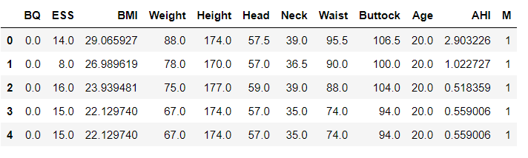
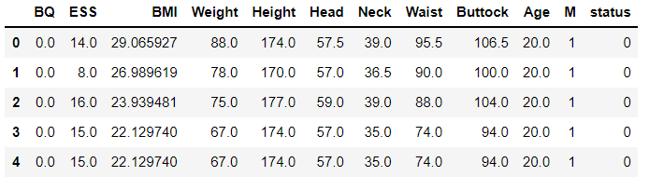
AHI LABELING
Apnea Severity | Apnea-Hypopnea Index | Labeling (Status)
Normal | <5 | 0
Mild | 5<=AHI<12 | 1
Moderate | 15<=AHI<30 | 2
Severe | >=30 | 3
AHI Before Label Encoding
AHI After Label Encoding

Slide 16
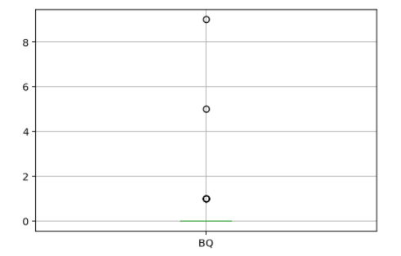
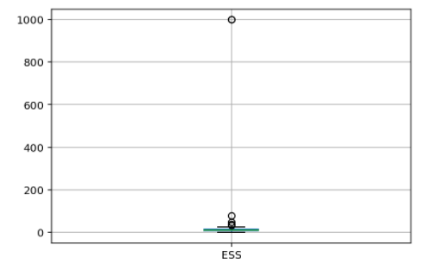
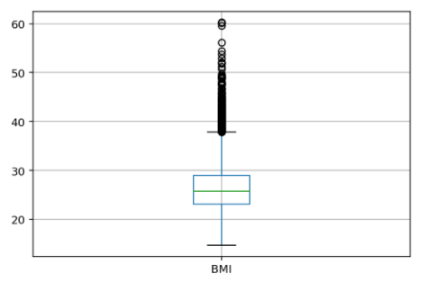
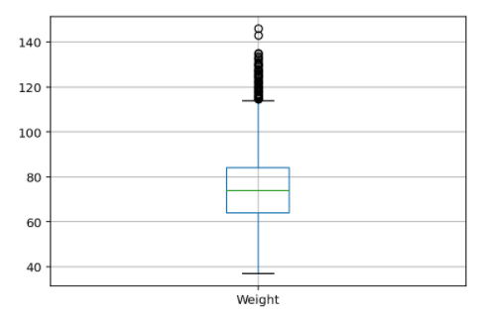
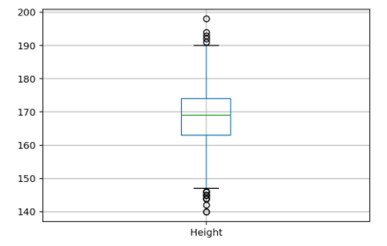
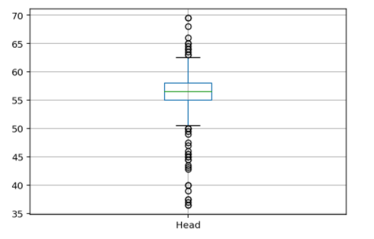
OUTLIERS REMOVAL

Slide 17
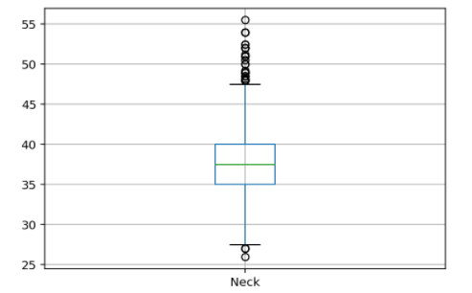
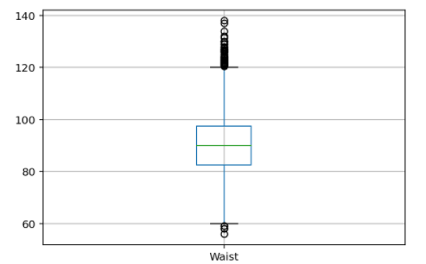
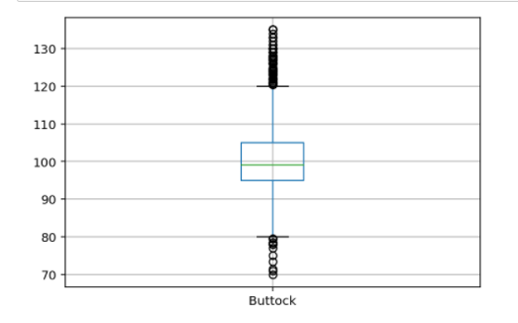
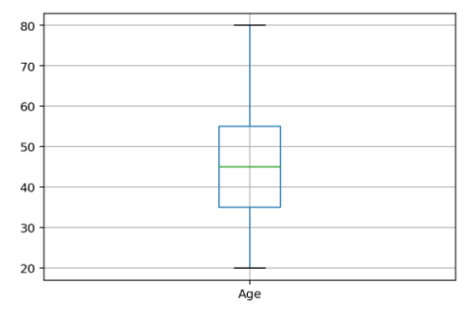

Slide 18
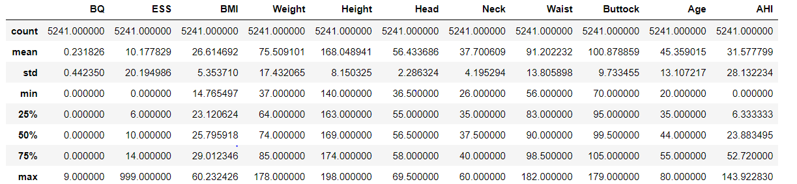
STATISTICAL DATA BEFORE PREPROCESSING

Slide 19
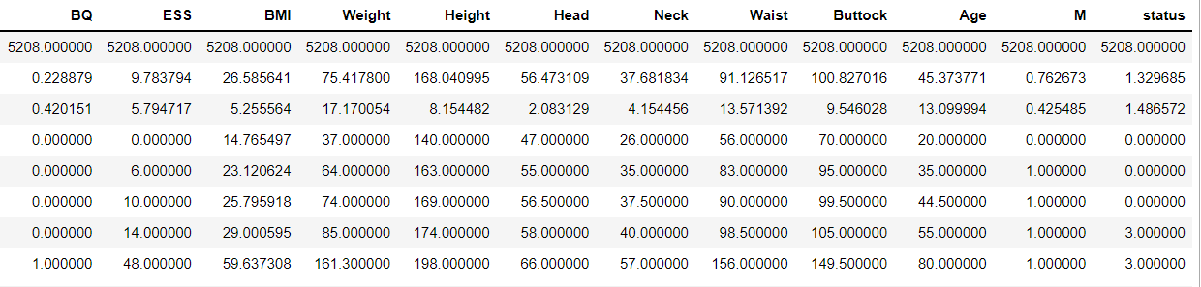
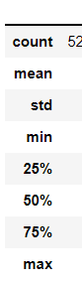
STATISTICAL DATA AFTER PREPROCESSING

Slide 20
TRAIN TEST SPLIT

Slide 21
DATA SET CLASSIFICATION
DATA SET
IMBALANCED DATA
BALANCED DATA
TYPE - 1
TYPE - 2

Slide 22
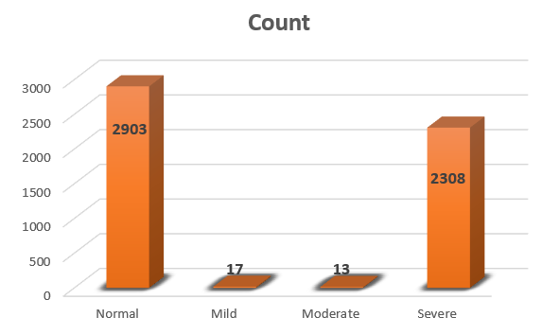
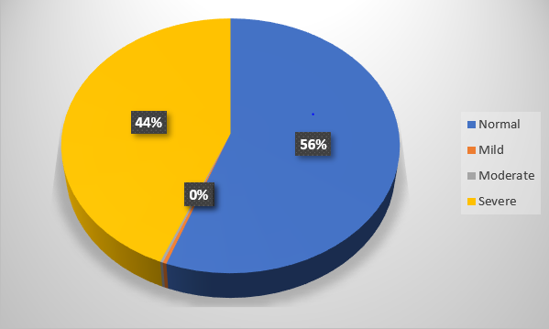
IMBALNACED DATASET

Slide 23
FEATURE SCORE

Slide 24
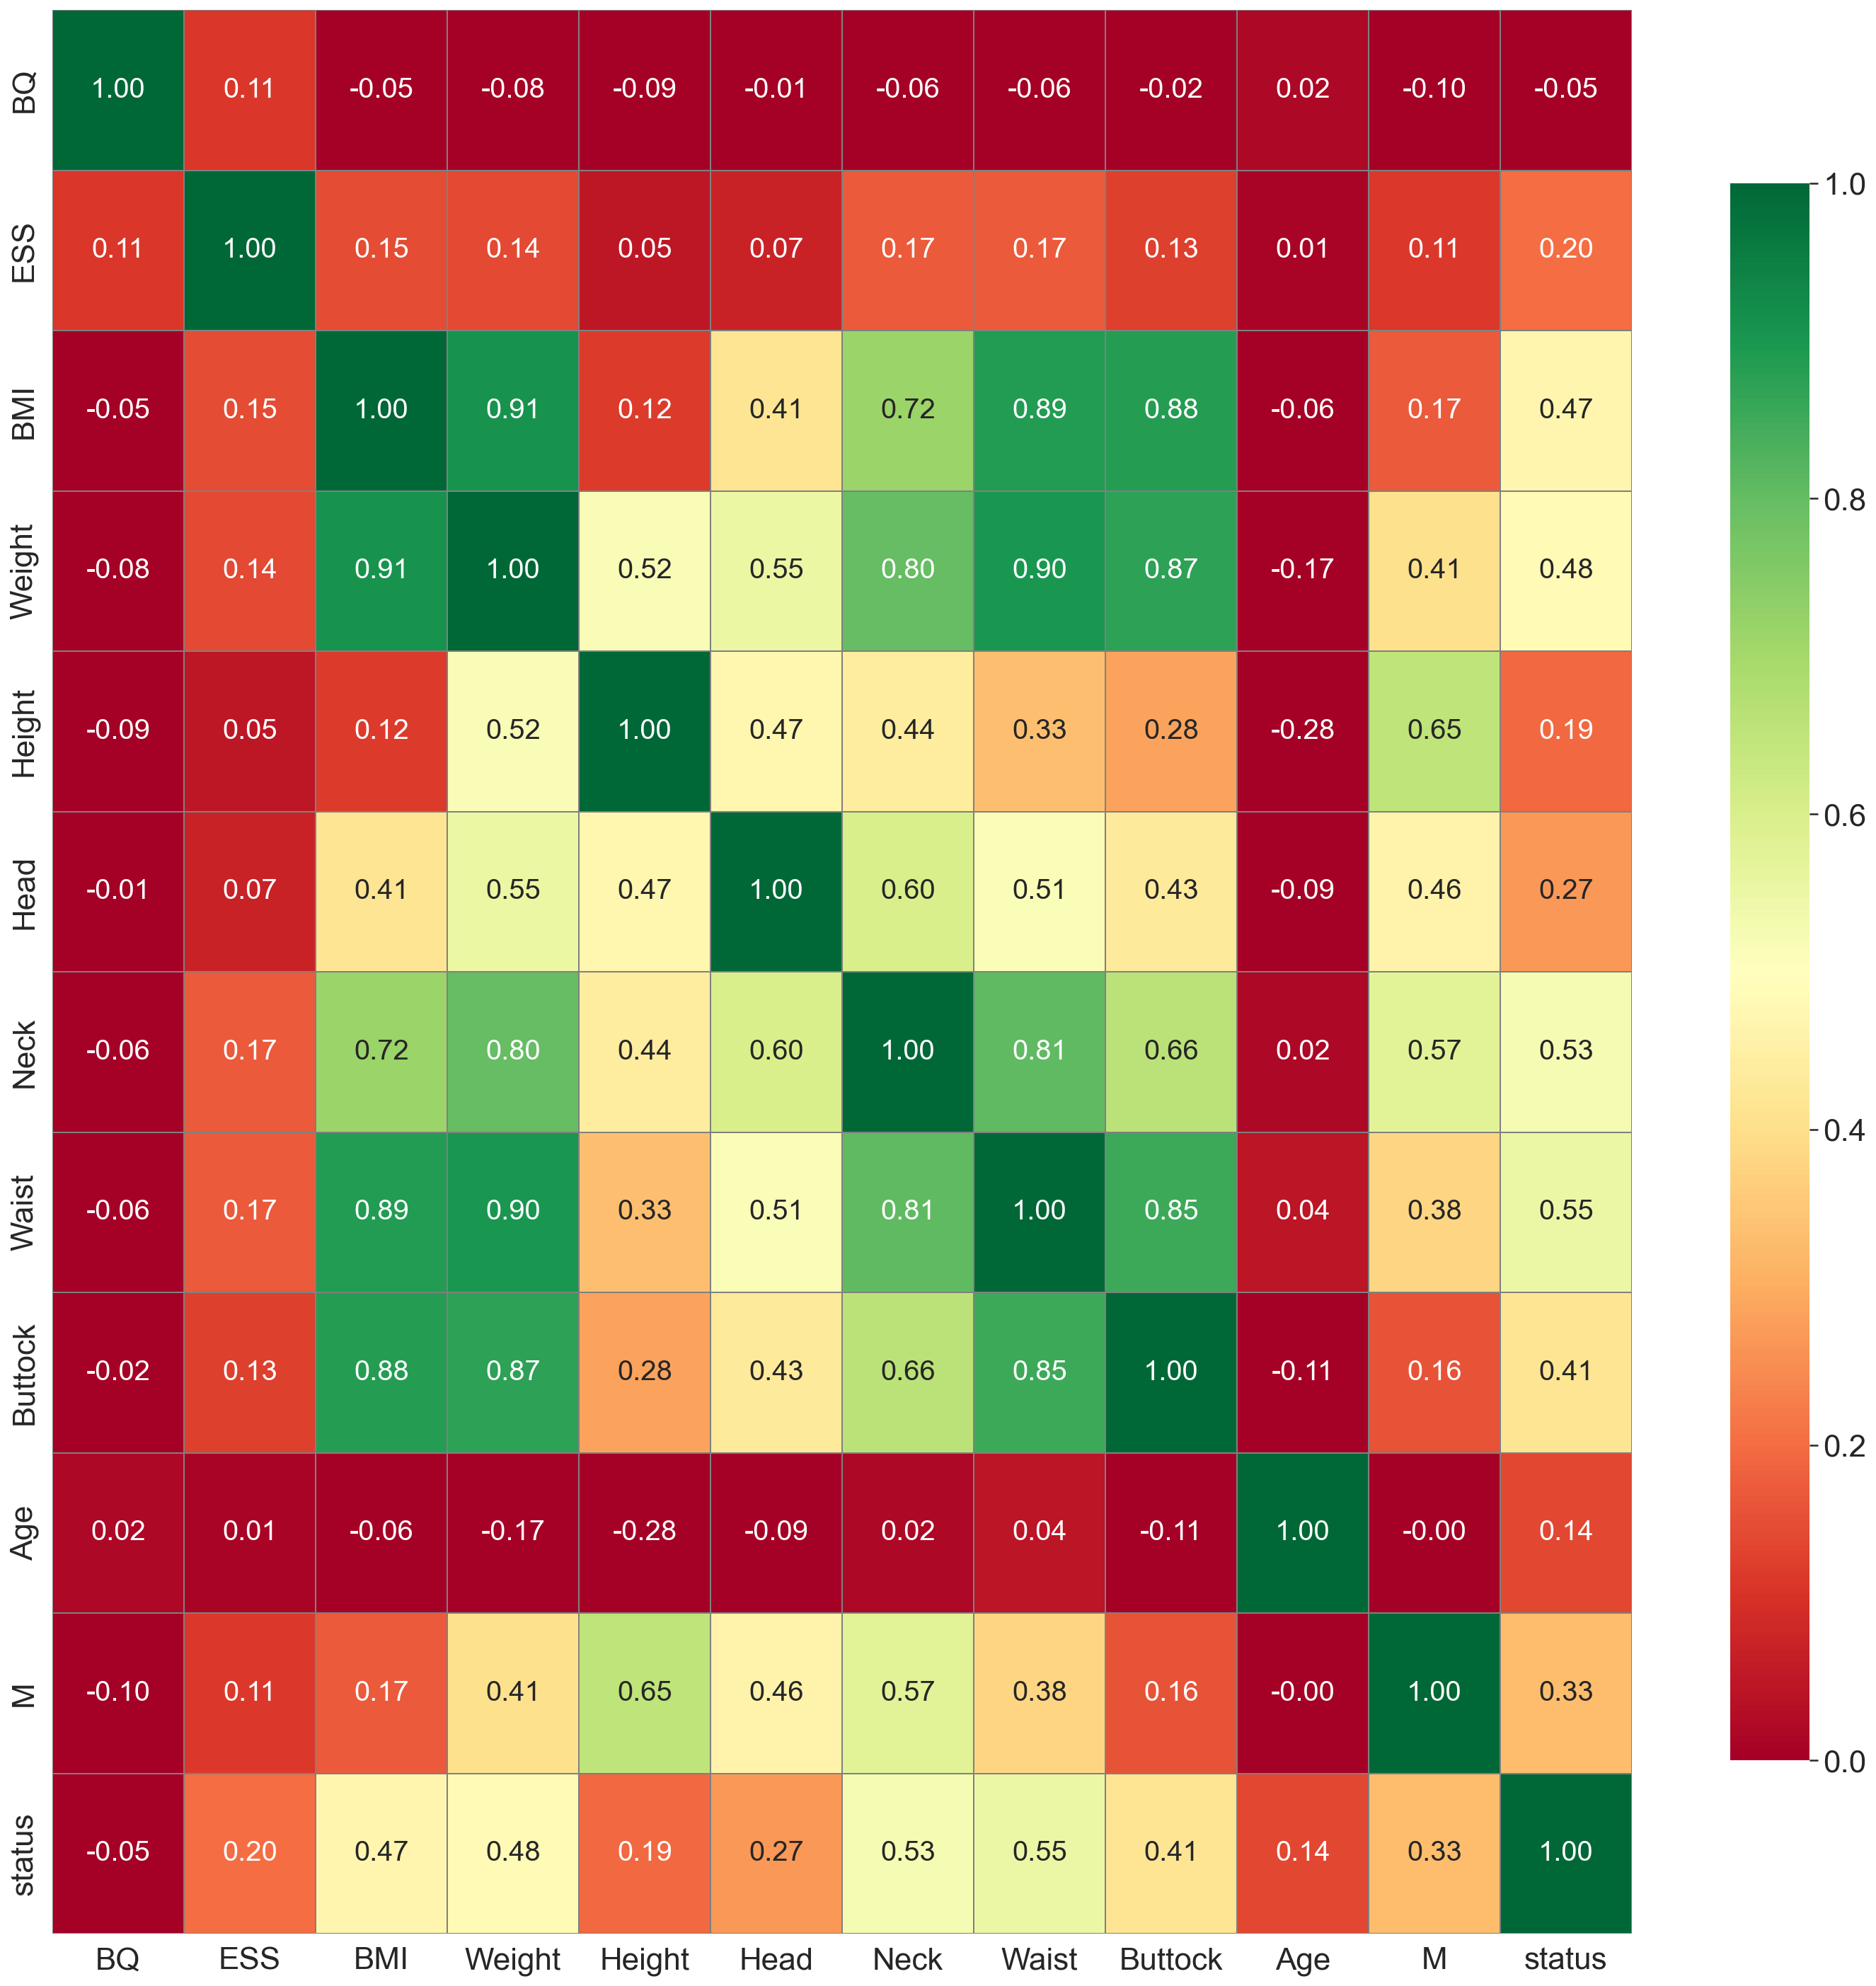
CO-RELATION MATRIX

Slide 25
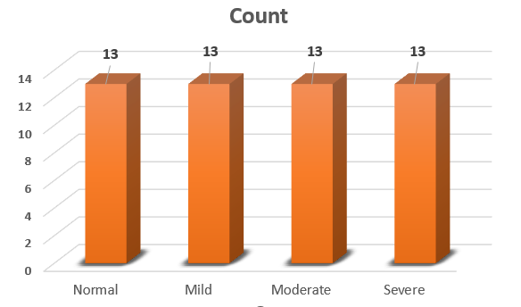
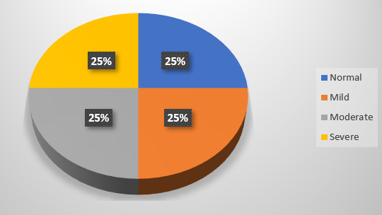
BALANCED DATA SET
TYPE-I
UNDER-SAMPLING

Slide 27
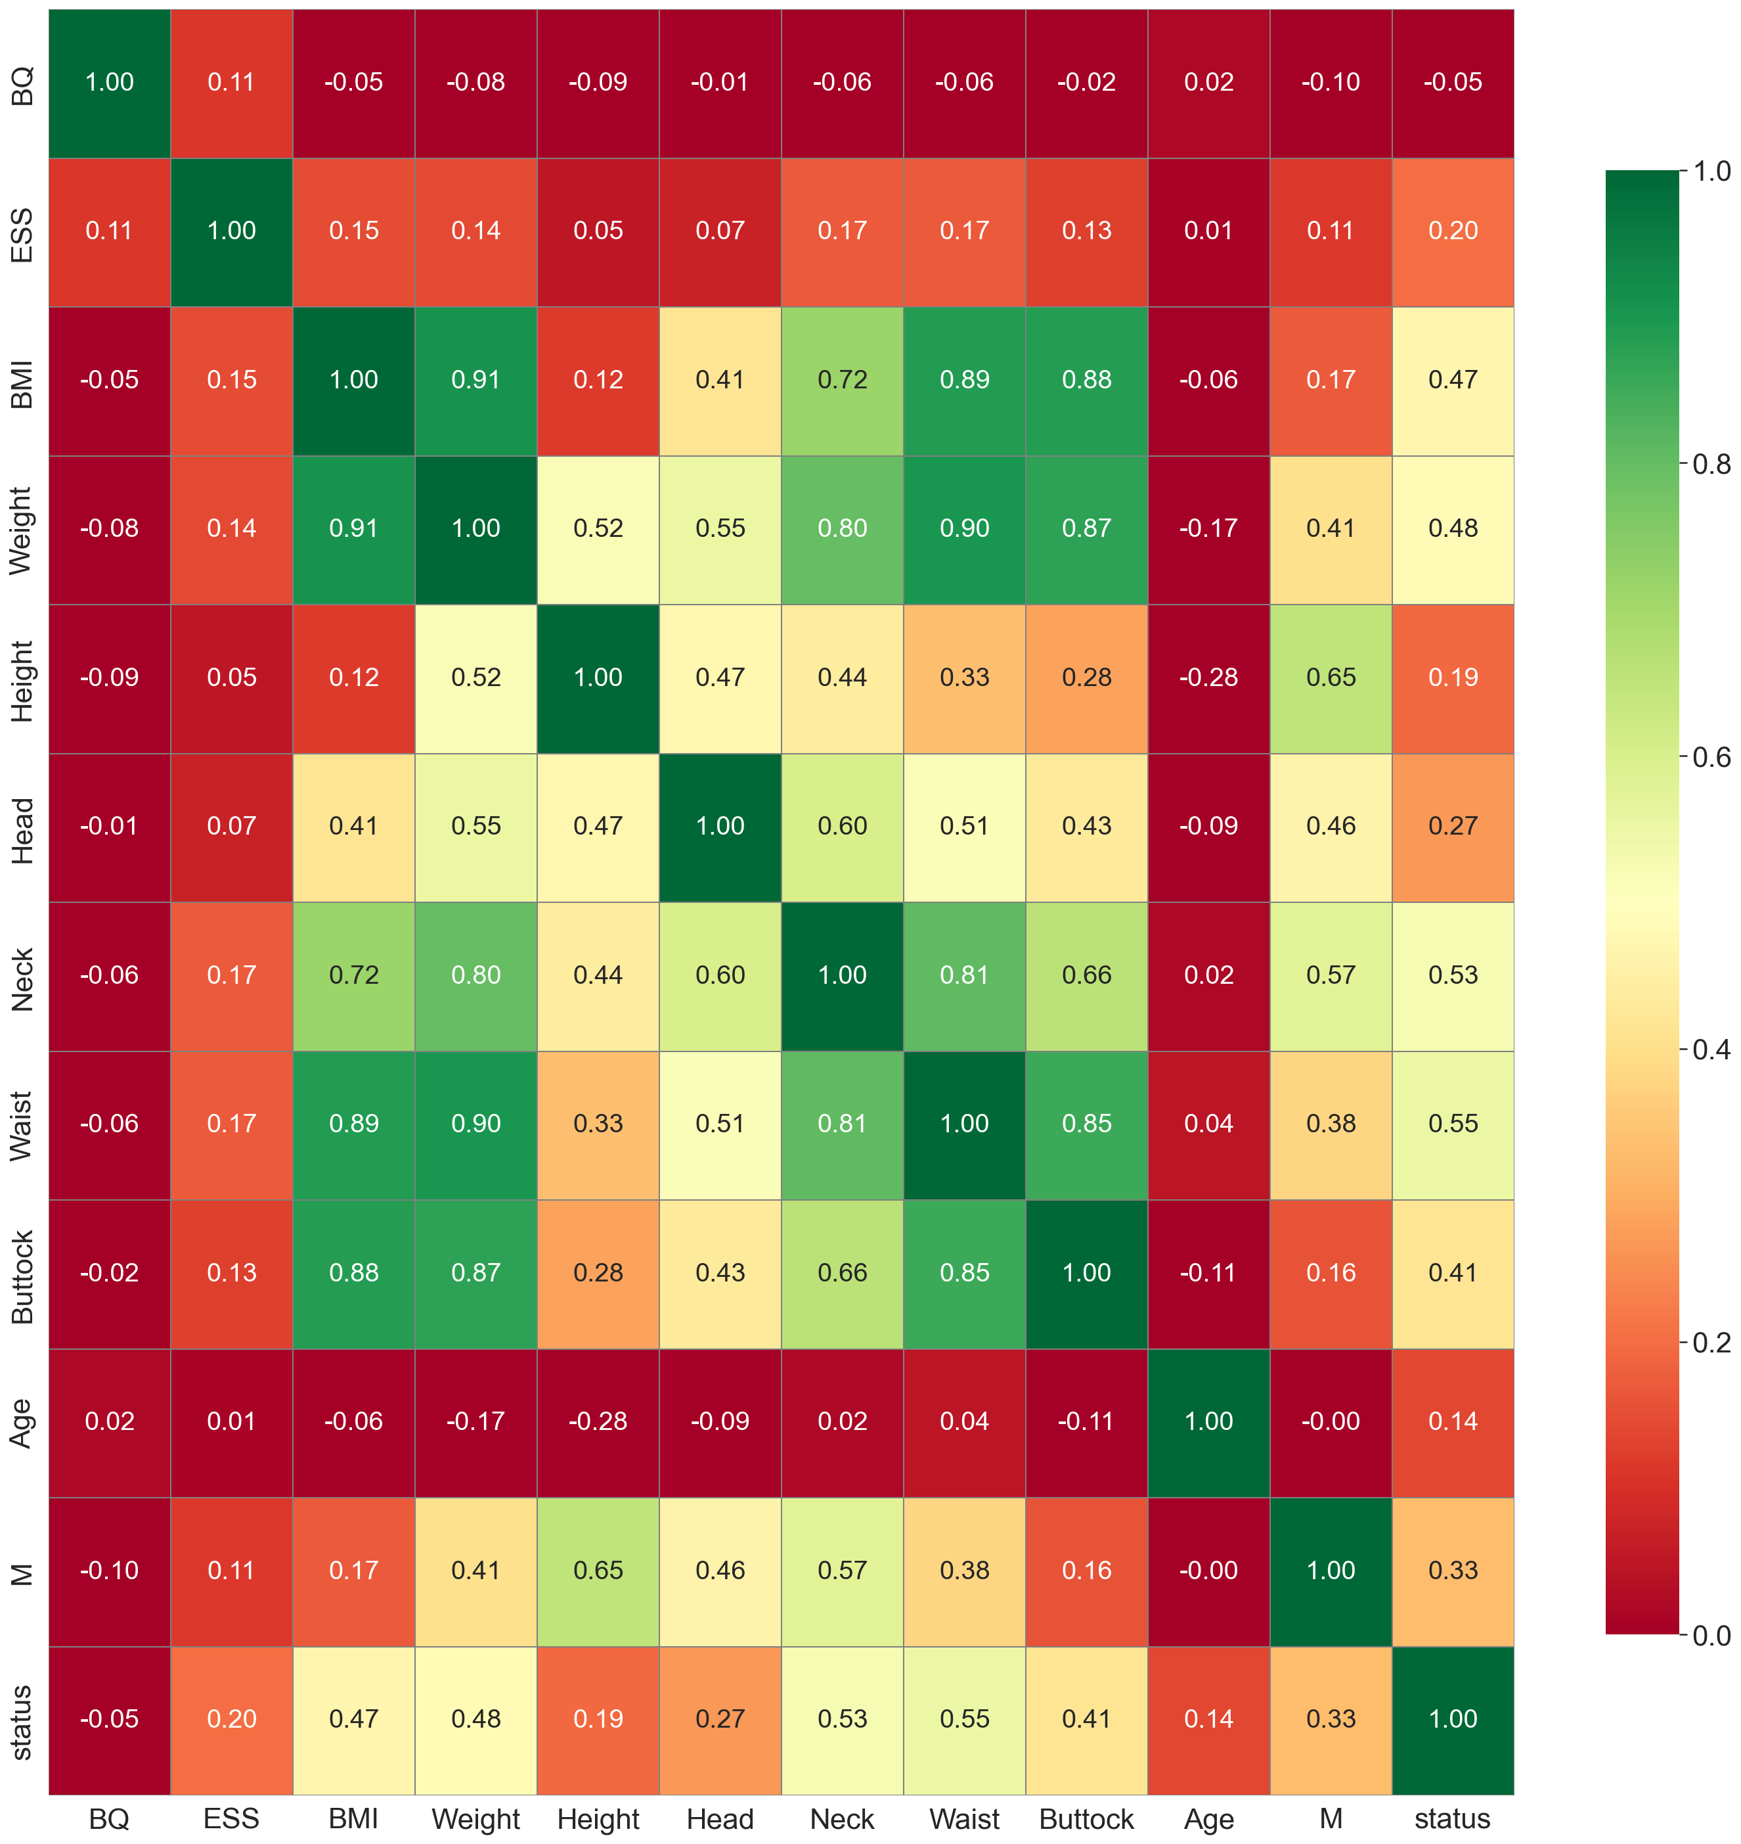

Slide 28
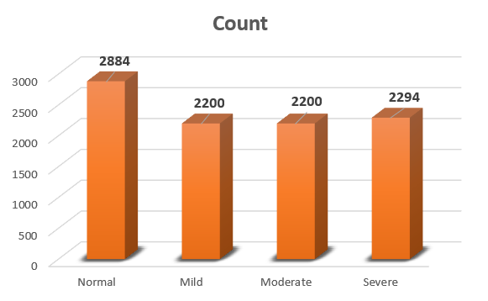
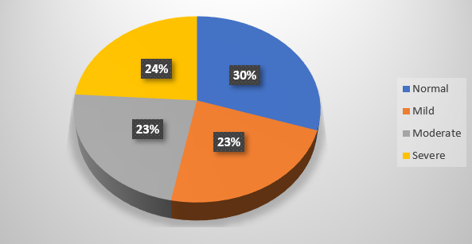
BALANCED DATA SET
TYPE-2
OVER-SAMPLING CASE-1

Slide 30
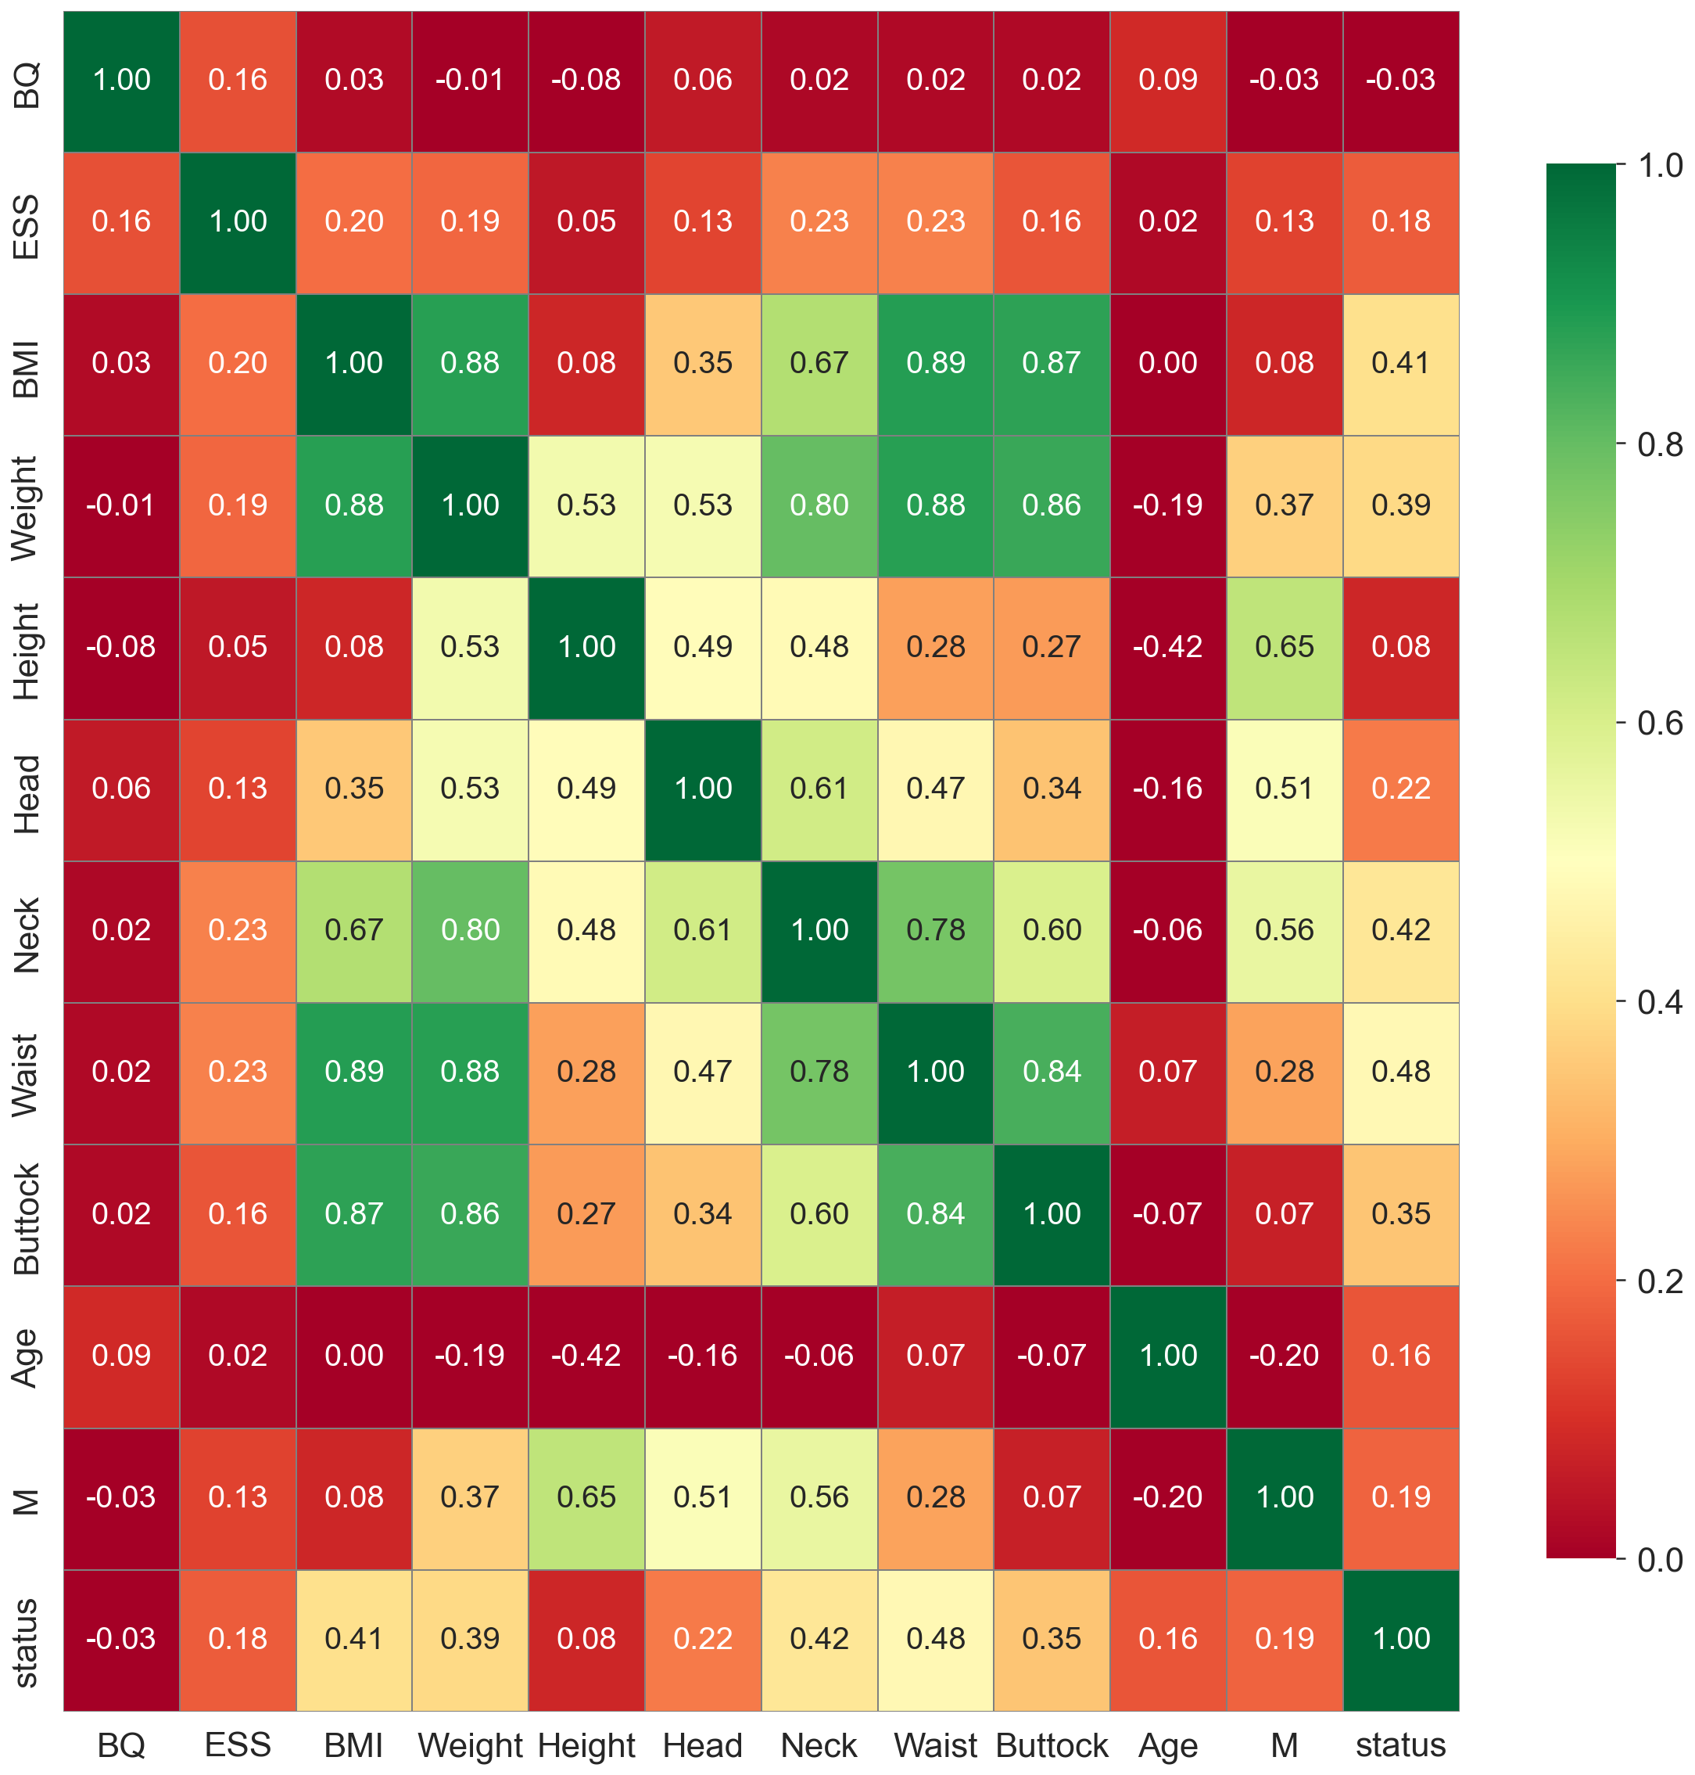

Slide 31
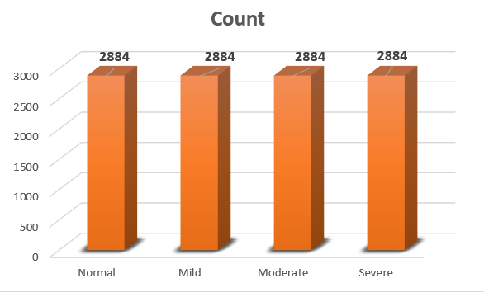
b. BALANCED DATASET
TYPE-II
OVER-SAMPLING CASE-2

Slide 33


Slide 34





CLASSFIERCLASSIFIER
APNEA
NO
NORMAL
YES
MILD
SEVERE
MODERATE

Slide 35
Classifiers
Performance Metrics
Logistic Regression
KNN
SVC
Decision Tree
Random Forest
Extra Tress
Linear SVC
GaussainNB
Accuracy
Precision
Recall
F1-Score
Roauc
Confusion Matrix
Time Taken (sec)

Slide 36
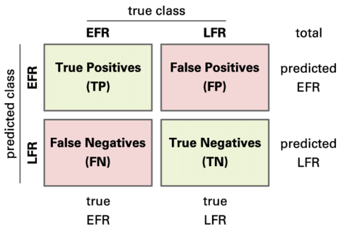
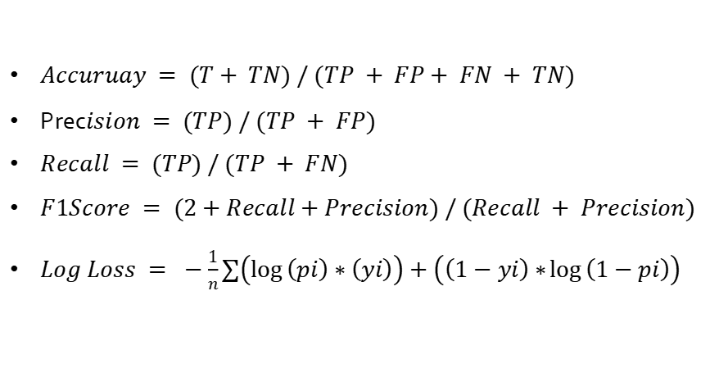
Performances Metrics Formulae
$Accuruay = (T+ TN) / (TP + FP+ FN + TN)$
Prec$ision = (TP) / (TP + FP)$
$Recall = (TP) / (TP + FN)$
$F1Score = (2+Recall+Precision) / (Recall + Precision)$
$Log Loss = −\frac{1}{n}∑\left(\log\left(pi\right)∗\left(yi\right)\right)+\left(\left(1−yi\right)∗\log\left(1−pi\right)\right)$

Slide 37
MODEL EVALUATION RESULTS
CASE – I (IMBALANCED DATASET)

Slide 38
CASE – I I (BALANCED DATASET)
UNDER-SAMPLED

Slide 39
CASE – I I (BALANCED DATASET)
UNDER-SAMPLED
CASE -I
CASE -II

Slide 40
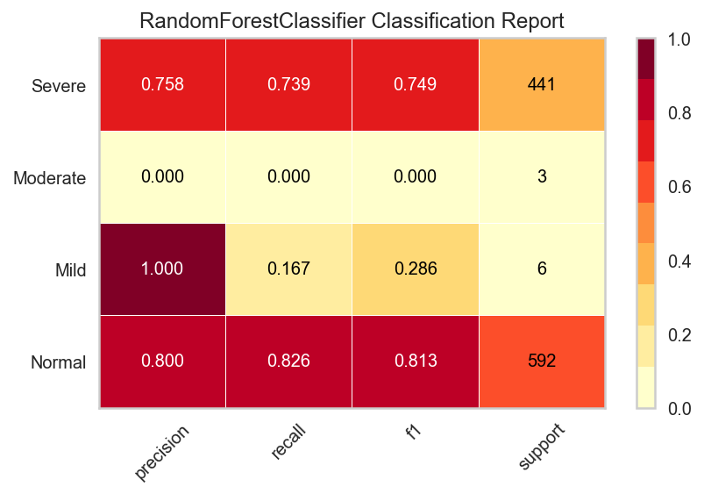
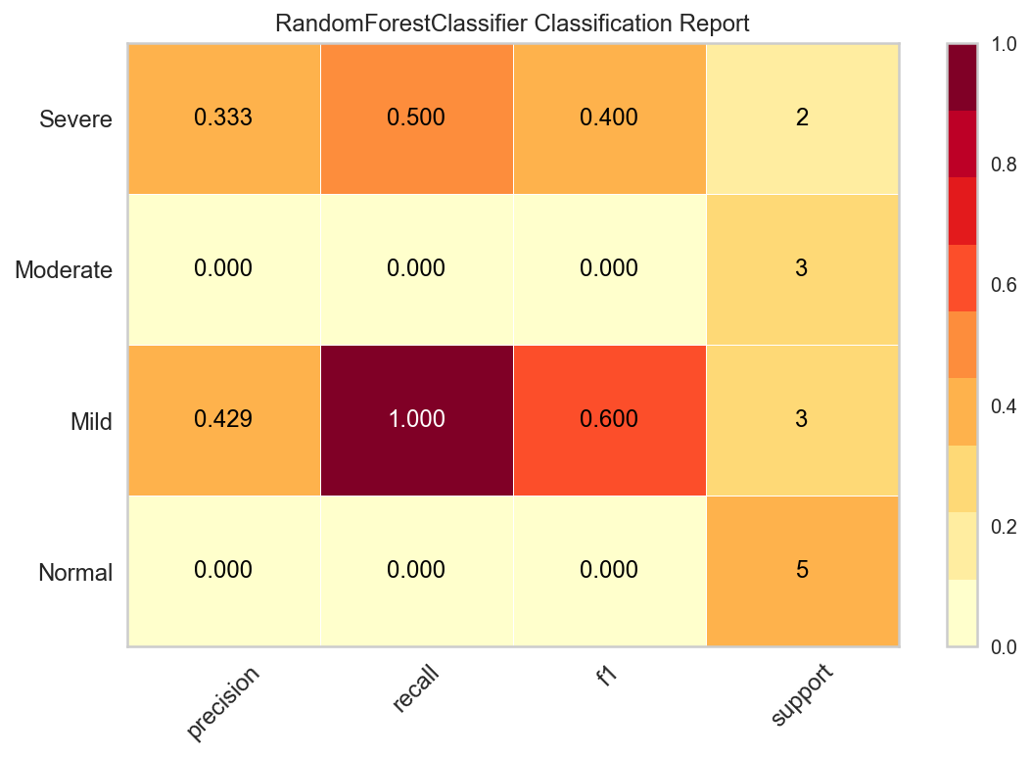
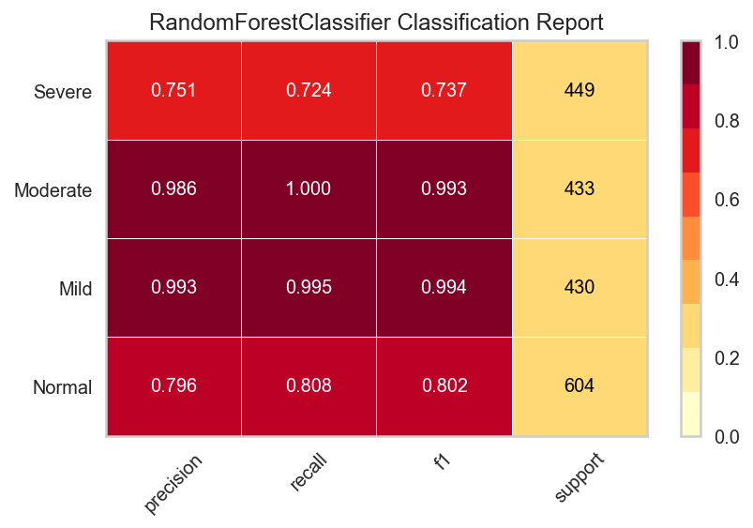
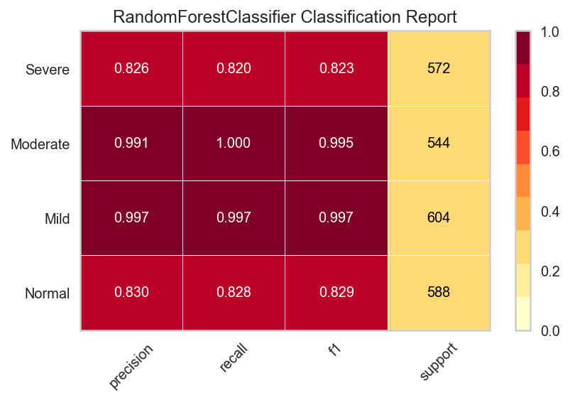
CASE -I
CASE -II
CLASSFICATION
REPORT
CASE -III
CASE -III
CASE -IV

Slide 41

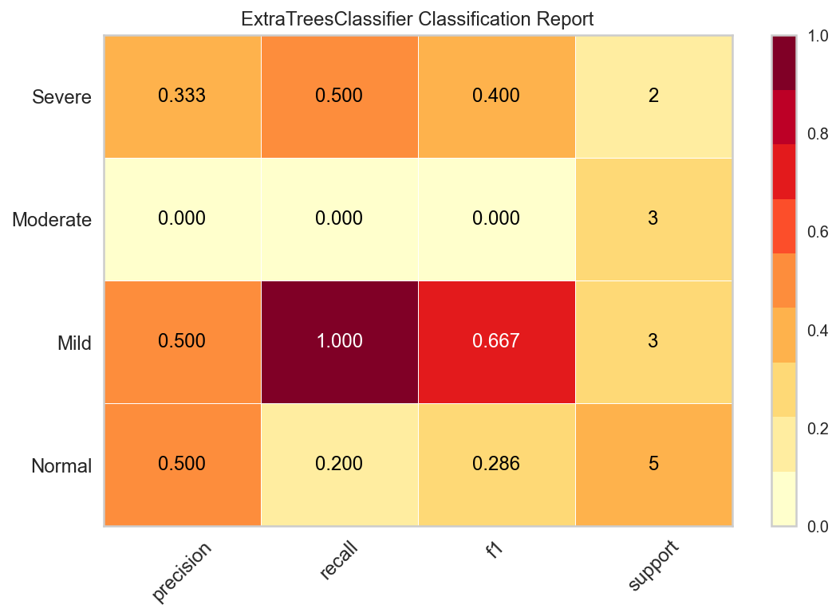
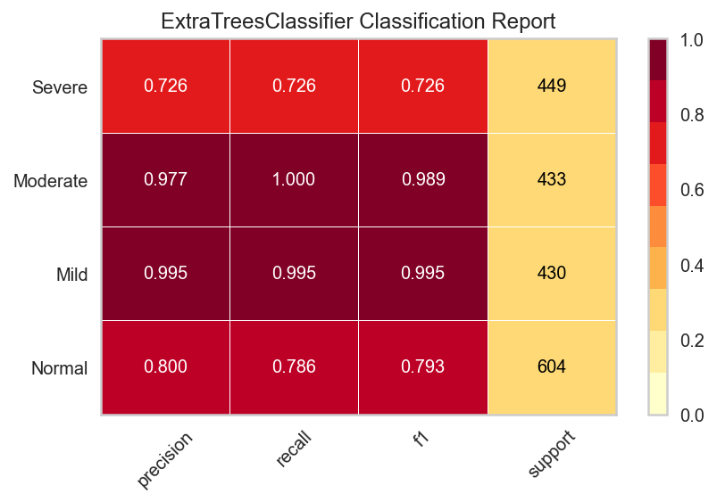

CASE -I
CASE -II
CASE -III
CASE -IV

Slide 42
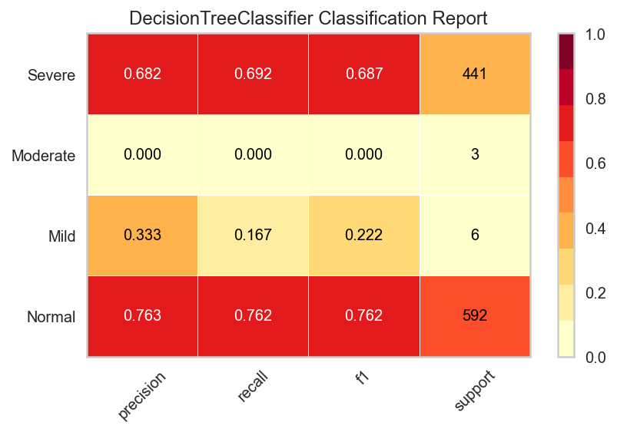
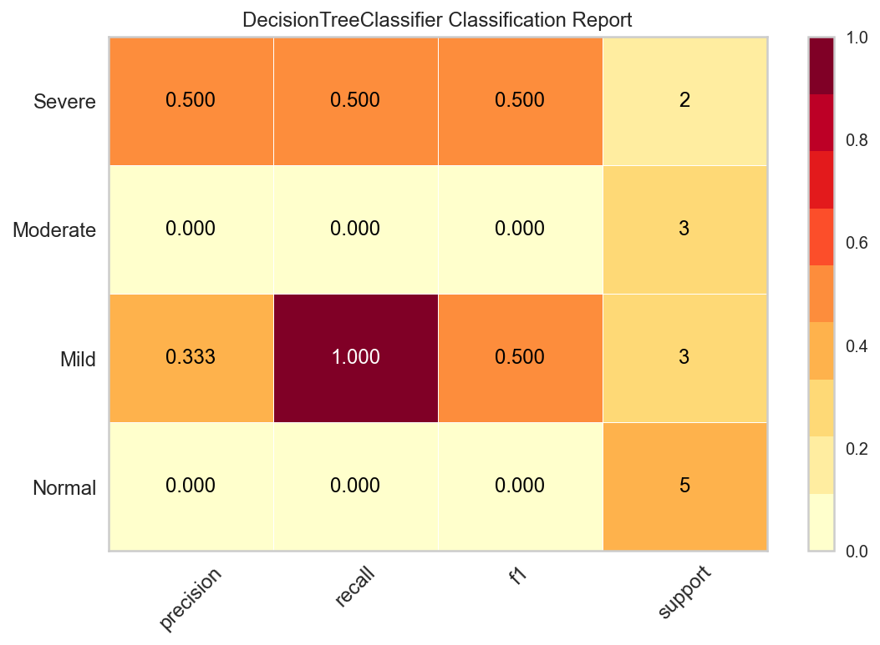
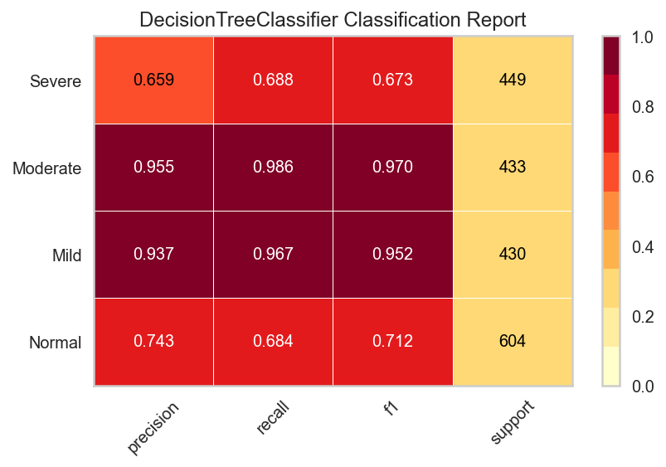
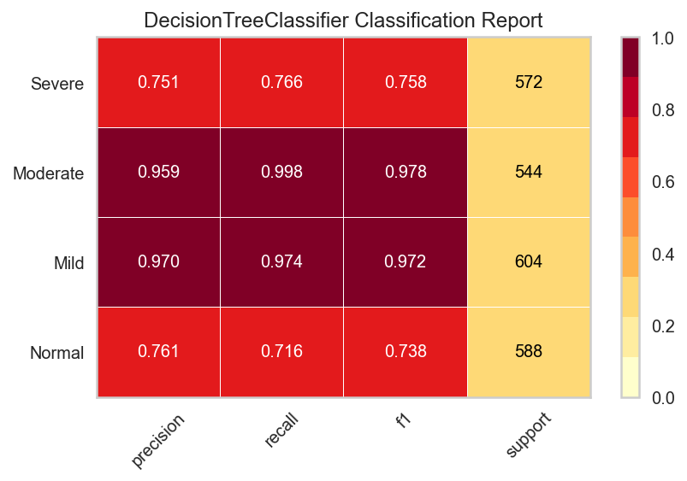
CASE -I
CASE -II
CASE -III
CASE -IV

Slide 43
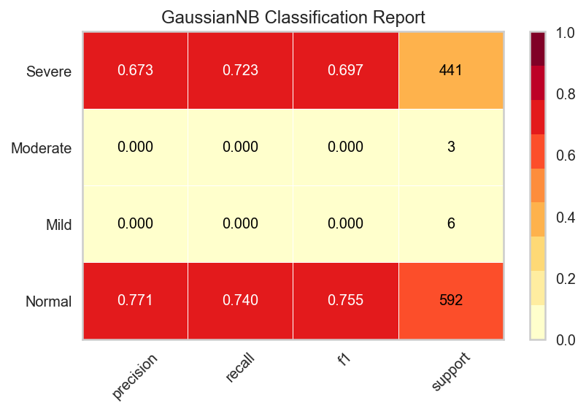
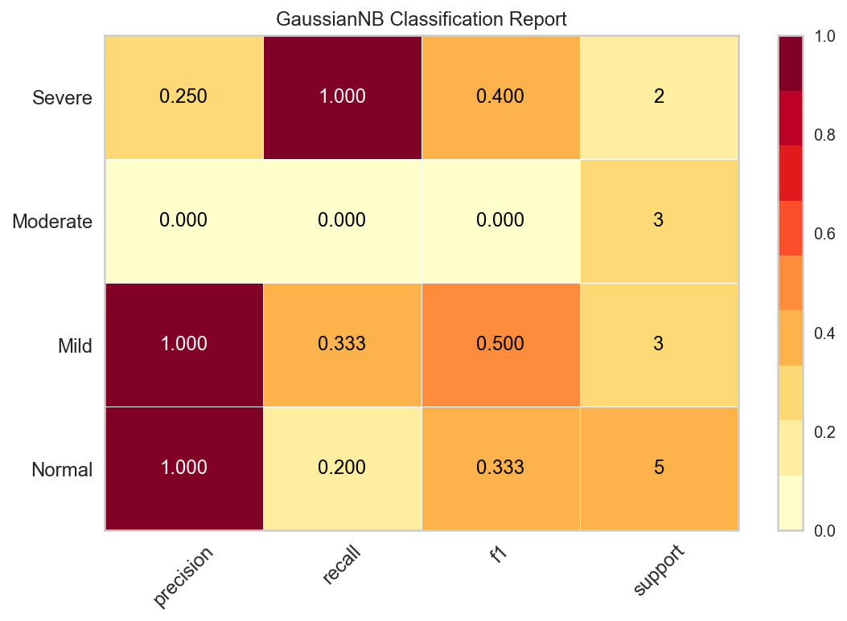
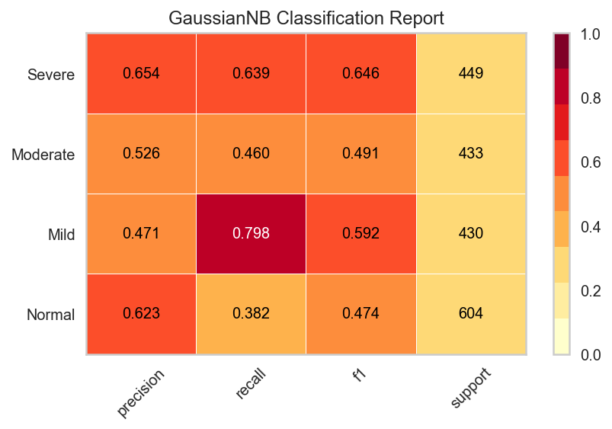
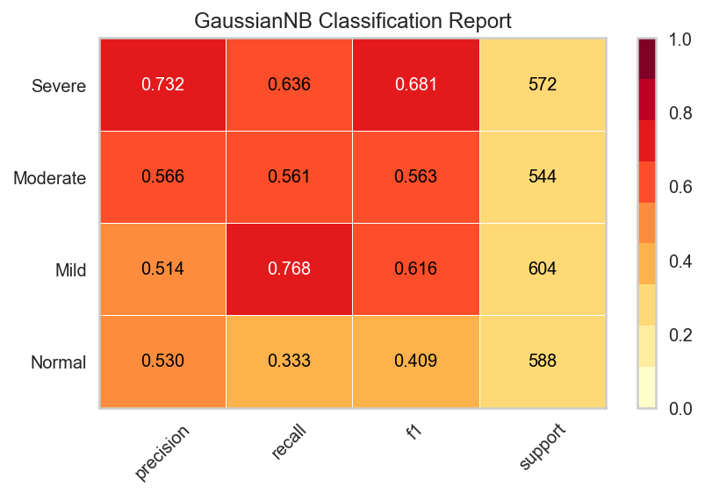
CASE -I
CASE -II
CASE -III
CASE -IV

Slide 44
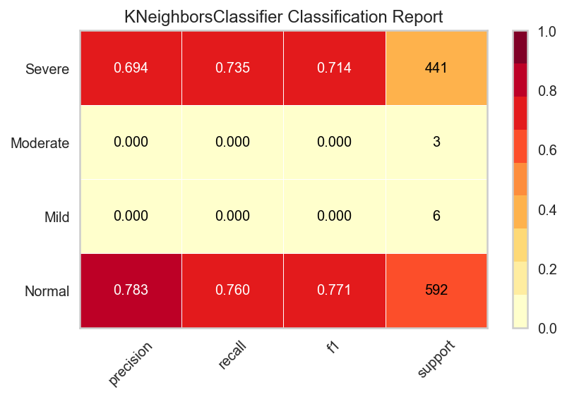



CASE -I
CASE -II
CASE -III
CASE -IV

Slide 45




CASE -I
CASE -II
CASE -III
CASE -IV

Slide 46




CASE -I
CASE -II
CASE -III
CASE -IV

Slide 47




CASE -I
CASE -II
CASE -III
CASE -IV

Slide 48




CASE -I
CASE -II
CLASS PREDICTION
CASE -III
CASE -IV

Slide 49




CASE -I
CASE -II
CASE -III
CASE -IV

Slide 50




CASE -I
CASE -II
CASE -III
CASE -IV

Slide 51
CASE -I
CASE -II
CASE -III
CASE -IV

Slide 52




CASE -I
CASE -II
CASE -III
CASE -IV

Slide 53




CASE -I
CASE -II
CASE -III
CASE -IV

Slide 54




CASE -I
CASE -II
CASE -III
CASE -IV

Slide 55




CASE -I
CASE -II
CASE -III
CASE -IV

Slide 56




CASE -I
CASE -II
CASE -III
CASE -IV

Slide 57




CASE -I
CASE -II
CONFUSION MATRIX
CASE -III
CASE -IV

Slide 58




CASE -I
CASE -II
CASE -III
CASE -IV

Slide 59




CASE -I
CASE -II
CASE -III
CASE -IV

Slide 60




CASE -I
CASE -II
CASE -III
CASE -IV

Slide 61




CASE -I
CASE -II
CASE -III
CASE -IV

Slide 62



CASE -I
CASE -II
CASE -III
CASE -IV

Slide 63




CASE -I
CASE -II
CASE -III
CASE -IV

Slide 64
COMPARATIVE ANALYSIS OF PERFORMANCE METRICS

Slide 67
Data Set | Classifiers | Accuracy | Precision | Recall | F1-Score | Time Taken
Imbalanced | Random Forest | 61.2 | 79 | 79 | 79 | 1.22
 | Decision Tree | 73 | 73 | 73 | 73 | 0.06
 | Extra Trees | 78.4 | 78 | 78 | 78 | 0.89
 | Logistic Regression | 75.7 | 75 | 76 | 75 | 0.3
 | SVC | 75.9 | 75 | 76 | 76 | 1.42
 | KNN | 74.9 | 74 | 75 | 75 | 0.11
 | Gaussian NB | 74.7 | 74 | 75 | 75 | 0.02
 | Linear SVC | 61.2 | 75 | 61 | 57 | 1.22
Under-Sampled | Random Forest | 30.7 | 15 | 38 | 25 | 0.09
 | Decision Tree | 30.7 | 21 | 38 | 25 | 0.01
 | Extra Trees | 38.4 | 19 | 38 | 25 | 0.15
 | Logistic Regression | 38.4 | 19 | 38 | 25 | 0.02
 | SVC | 30.7 | 18 | 42 | 23 | 0.007
 | KNN | 23 | 17 | 26 | 20 | 0.019
 | Gaussian NB | 30.7 | 56 | 38 | 31 | 0.014
 | Linear SVC | 30.7 | 19 | 50 | 28 | 0.02
Over-Sampled | Random Forest | 91 | 91 | 91 | 91 | 0.82
 | Decision Tree | 83.1 | 86 | 90 | 86 | 0.04
 | Extra Trees | 90.3 | 90 | 86 | 90 | 0.57
 | Logistic Regression | 52.2 | 52 | 52 | 51 | 0.38
 | SVC | 56.1 | 58 | 56 | 55 | 3.87
 | KNN | 83.1 | 83 | 83 | 82 | 0.11
 | Gaussian NB | 57.5 | 58 | 58 | 57 | 0.57
 | Linear SVC | 31.3 | 30 | 31 | 21 | 1.32

Slide 68

USER INTERFACE

Slide 69



Slide 70



Slide 71
REFERENCES
Young T, Palta M, Dempsey J, Peppard PE, Nieto FJ, Hla KM. Burden of sleep apnea: rationale, design, and major findings of the Wisconsin Sleep Cohort study. WMJ: official publication of the State Medical Society of Wisconsin. 2009 Aug;108(5):246
Peppard, P.E., Young, T., Barnet, J.H., Palta, M., Hagen, E.W. and Hla, K.M., 2013. Increased prevalence of sleep-disordered breathing in adults. American journal of epidemiology, 177(9), pp.1006-1014.
Vgontzas, A.N., Papanicolaou, D.A., Bixler, E.O., Hopper, K., Lotsikas, A., Lin, H.M., Kales, A. and Chrousos, G.P., 2000. Sleep apnea and daytime sleepiness and fatigue: relation to visceral obesity, insulin resistance, and hypercytokinemia. The Journal of Clinical Endocrinology & Metabolism, 85(3), pp.1151-1158.
Golbidi, S., Badran, M., Ayas, N. and Laher, I., 2012. Cardiovascular consequences of sleep apnea. Lung, 190(2), pp.113-132.
Canessa, N., Castronovo, V., Cappa, S.F., Aloia, M.S., Marelli, S., Falini, A., Alemanno, F. and Ferini-Strambi, L., 2011. Obstructive sleep apnea: brain structural changes and neurocognitive function before and after treatment. American journal of respiratory and critical care medicine, 183(10), pp.1419-1426.
Yaggi, H.K., Concato, J., Kernan, W.N., Lichtman, J.H., Brass, L.M. and Mohsenin, V., 2005. Obstructive sleep apnea as a risk factor for stroke and death. New England Journal of Medicine, 353(19), pp.2034-2041.

Slide 72
THANK YOU

